Slide 1


Unit 6.2 – Requirement Engineering

Slide 2
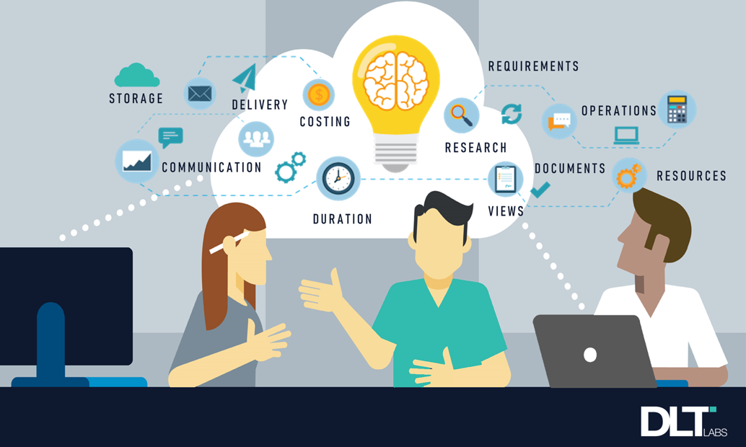
What is a Requirement?

Slide 3
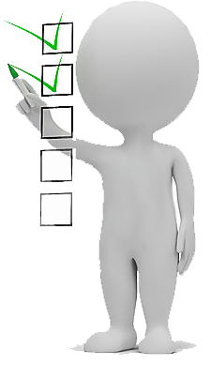
What is a Requirement?
It describes what the system should do, the service or services that it provides, and the constraints on its operation.

Slide 4
Functional Requirements
Functional requirements: statements of services the system should provide, how the system should react to inputs, and how the system should behave in specific situations.
1 The system must send a confirmation email whenever an order is placed.
2 The system must allow blog visitors to sign up for the newsletter by leaving their email.
3 The system must allow users to verify their accounts using their phone number.

Slide 5
Non-functional Requirements
Non-functional requirements: constraints on the services or functions offered by the system such as timing constraints, constraints on the development process, standards, etc.
Portability
Security
Privacy
Safety
Maintainability
Reliability
Scalability
Performance
Reusability
Flexibility

Slide 6
Functional x Non-Functional Requirements
Functional Requirements
User Requirements
Product Features
Non-Functional Requirements
User Expectations
Product Properties

Slide 7
What is a Requirement Elicitation?

Slide 8

System Requirement Definition
Two questions need to be answered:
How can we identify the purpose of a system?
What is inside, what is outside the system?

Slide 9
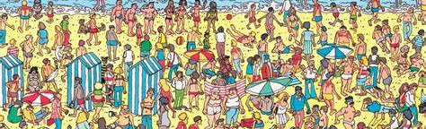
What is Requirement Elicitation?
It is the practice of researching and discovering the requirements of a system from users, customers, and other stakeholders.

Slide 10
Requirement Elicitation Techniques
Questionnaires: Asking the end user a list of pre-selected questions
Task Analysis: Observing end users in their operational environment
Scenarios: Describe the use of the system as a series of interactions between a concrete end user and the system
Use cases: Abstractions that describe a class of scenarios.

Slide 11
Requirements Elicitation: Difficulties and Challenges
Communicate accurately about the domain and the system
People with different backgrounds must collaborate to bridge the gap between end users and developers
Client and end users have application domain knowledge
Developers have solution domain knowledge
Identify an appropriate system (Defining the system boundary)
Provide an unambiguous specification
Leave out unintended features

Slide 12
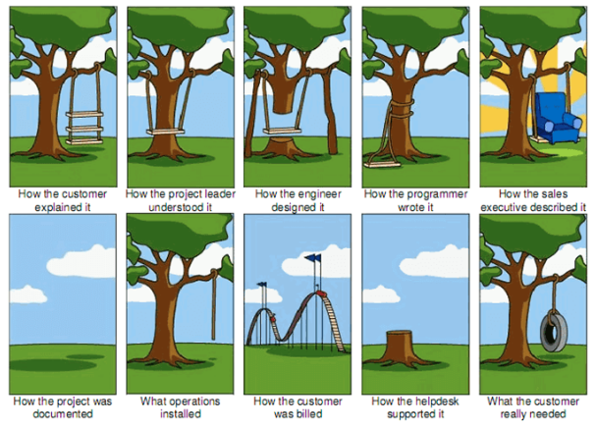

Slide 13
Example of an Unintended Feature
From the News: London underground train leaves station without driver!
What happened?
A passenger door was stuck and did not close
The driver left his train to close the passenger door
He left the driver door open
He relied on the specification that said the train does not move if at least one door is open
When he shut the passenger door, the train left the station without him
The driver door was not treated as a door in the source code!

Slide 14
How to report a Requirement?

Slide 15
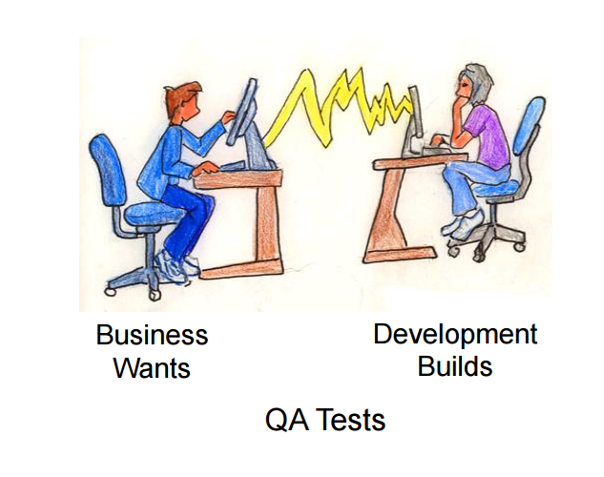
User Story
Represents and specifies the requirement or functionality of the application from the perspective of the user or customer.
It constitutes a promise of future conversation between the client and the developer.
So, it is not necessary to detail it too much!

Slide 16

You do not need Agile methods if you know what to build, who build it for, and how to build it.
Initial Plan
Use agile when you have uncertainty…
Better Plan
What to build
How to build it
Who to build it

Slide 17

User Stories Elaboration
Analysts prepare User Stories based on the features and non-functionalities raised by the application.

Slide 18

User Stories Elaboration
User Stories should be short, simple, and clear.
We should be able to write them on a simple little card.

Slide 19
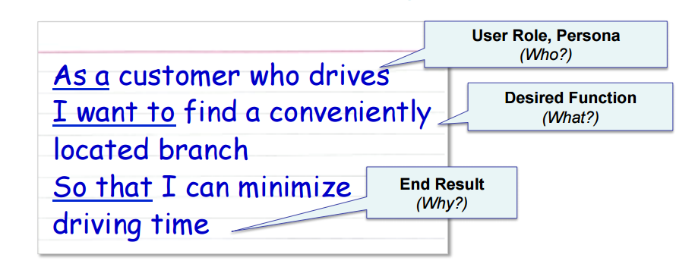
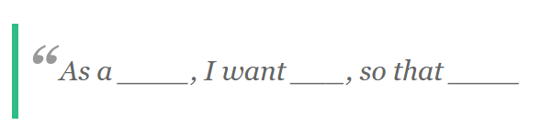
User Stories Elaboration

Slide 20
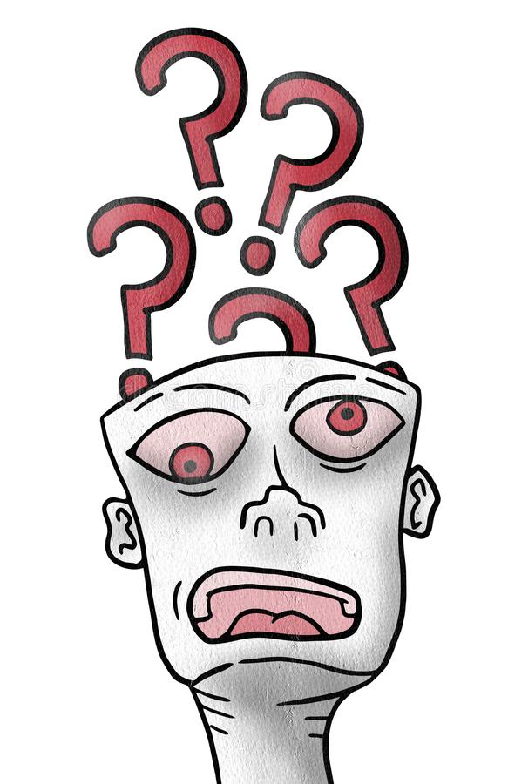
Exercise 1
The application authenticates with the HTTP proxy server.
What is wrong??

Slide 21

Exercise 1
WHO???
As a sysadmin, I want to make the Application authenticate with the HTTP proxy server to avoid users being tricked by a fake website (phishing).
WHAT???
WHY???
Notes:
Acceptance criteria is about how do you prove that you accomplish the user story!
As a developer, I want to make the Application authenticate with the HTTP proxy server to avoid that users be tricked by a fake website (phishing).
Acceptance Criteria:
Check that application does not have any direct access to the server.

Slide 22

Exercise 2
The system prevents users from running multiple instances of the application simultaneously.
Transform it in a User Story!

Slide 23
Exercise 2
WHO???
As an admin, I want to prevents the user from running multiple instances of the application simultaneously, aiming the system does not consume unnecessary resources.
WHAT???
WHY???
Notes:
As a user, I want to prevents the user from running multiple instances of the application simultaneously, aiming the system does not consume unnecessary resources.
Acceptance Criteria:
Check that the instance of any session has the same id instance number.

Slide 24
Convert the requirement to a user story
1 The system must send a confirmation email whenever an order is placed.

Slide 25
Convert the requirement to a user story
1 The system must send a confirmation email whenever an order is placed.
As a user, I want that system sends a confirmation email whenever an order is placed, aiming that he can identify the existent transactions.

Slide 26
Convert the requirement to a user story
2 The system must allow blog visitors to sign up for the newsletter by leaving their email.

Slide 27
Convert the requirement to a user story
2 The system must allow blog visitors to sign up for the newsletter by leaving their email.
As a blog visitor, I want that system must allow to visitors sign up for the newsletter by leaving their email, aiming that my blogs can be accessed.

Slide 28
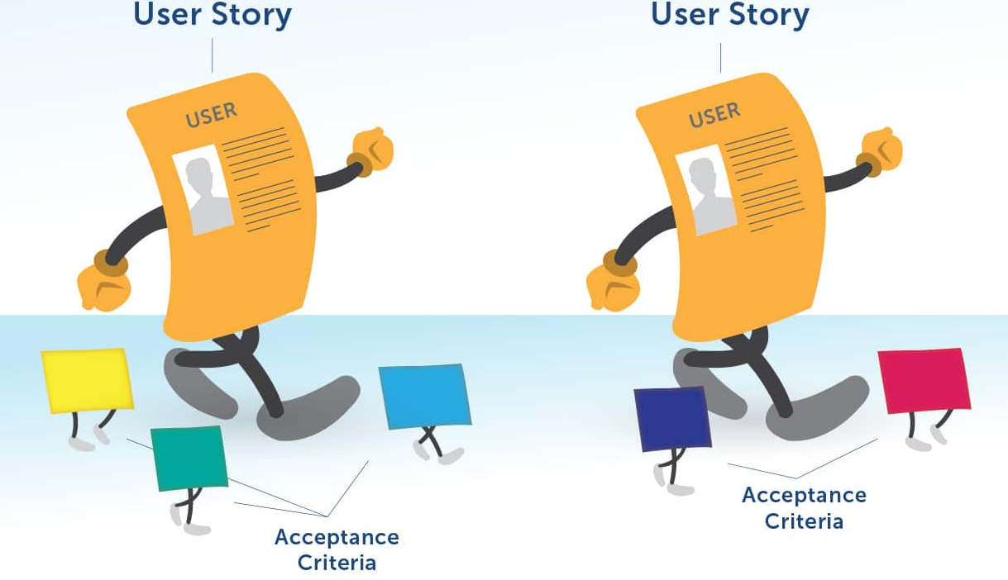
Acceptance Criteria
Acceptance Criteria refers to a set of predefined requirements that must be met in order to mark a user story complete.
Conditions that a software product must satisfy to be accepted by a user, customer, or another stakeholder.
Pre-established standards or requirements a product or project must meet.
Notes:
https://www.seguetech.com/what-characteristics-make-good-agile-acceptance-criteria/

Slide 29
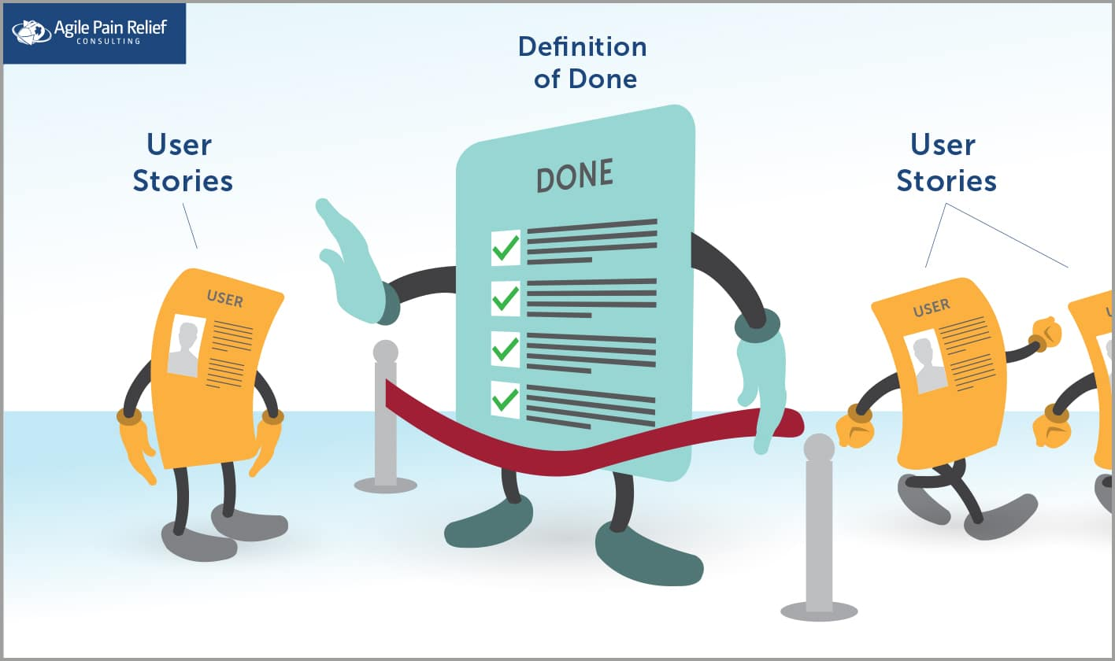
Acceptance Criteria
Acceptance criteria are also sometimes called the “definition of done” because they determine the scope and requirements that developers must execute to consider the finished user story.

Slide 30
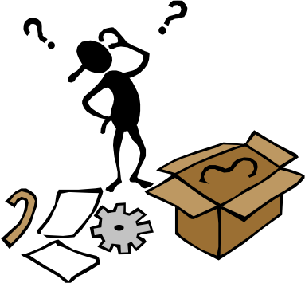
Acceptance Criteria & Non-Functional Requirements
For non-functional requirements that affect nearly all (functional) user stories, the best place to document them is as the Definition of Done.

Slide 31
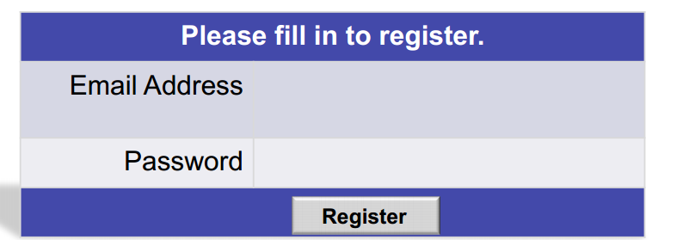
Acceptance Criteria Example
As a user, I want to register and log in with a secure password to prevent the system from being compromised.
What constraints should we impose?
What does mean secure password?
Notes:
Testing a Registration Function
What constraints should we impose?
Business Stakeholders and PO agree that passwords should not be easy to crack.
As a user, I want to login in the system using a strong password.
Acceptance Criteria:
Check that password has at least 8 characters and no more than 12
Check that password must contain only alphanumeric
Check that password must contain at least one digit
As a user, I want to prevents the user from running multiple instances of the application simultaneously, aiming the system does not consume unnecessary resources.
ORIG USER STORY / accept crit = {
us2 + accept crit
us3 + accept crit
us4 + accept crit
Us5 + accept
}

Slide 32
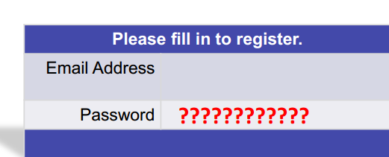
Acceptance Criteria Example
A secure password means:
Must be at least 8 characters and no more than 12
Must contain only alphanumeric
Must contain at least one digit
Must contain at least one alpha-character
Notes:
Testing a Registration Function
What constraints should we impose?
Business Stakeholders and PO agree that passwords should not be easy to crack.
As a user, I want to login in the system using a strong password.
Acceptance Criteria:
Check that password has at least 8 characters and no more than 12
Check that password must contain only alphanumeric
Check that password must contain at least one digit
As a user, I want to prevents the user from running multiple instances of the application simultaneously, aiming the system does not consume unnecessary resources.
ORIG USER STORY / accept crit = {
us2 + accept crit
us3 + accept crit
us4 + accept crit
Us5 + accept
}

Slide 33
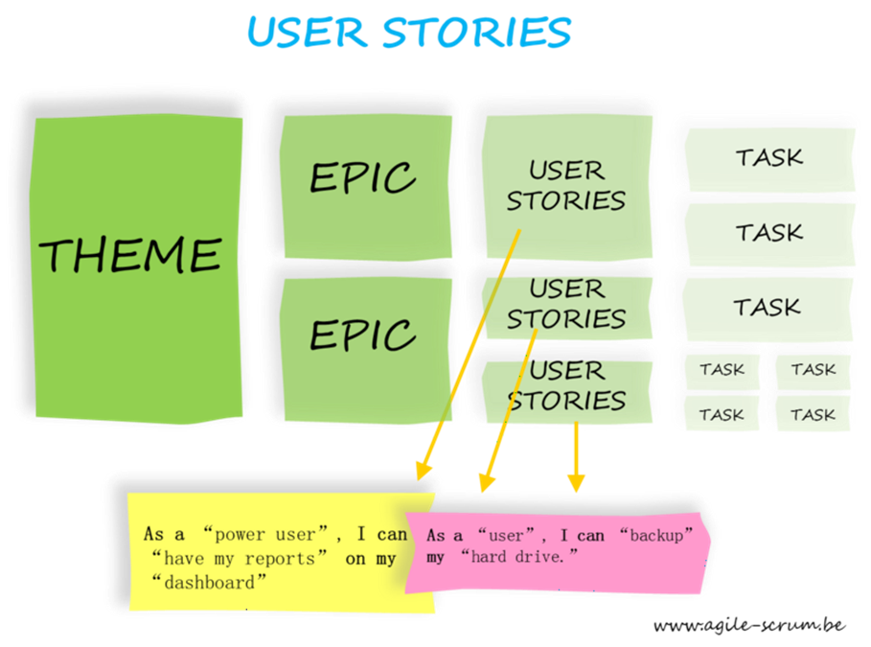

Slide 34

What is a Theme?
Themes or Features: may be thought of as groups of related stories.
They are tangible expressions of functionality but still too large to build.

Slide 35
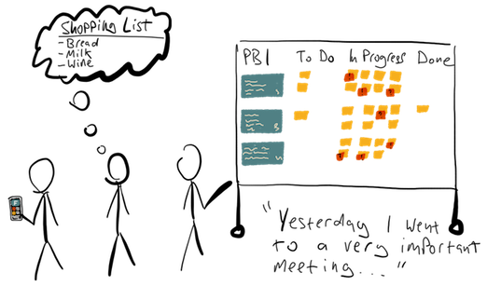
What is a Theme?
Themes/Features are often used to organize stories into releases;
OR
To organize them so that various sub teams can work on them.

Slide 36
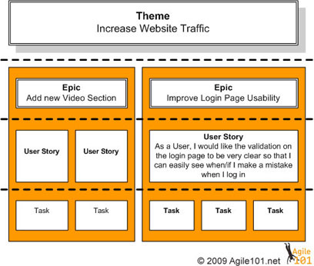
What is an Epic?
Resemble themes in the sense that they are made up of multiple stories.
They may also resemble stories in the sense that, at first, many appear to be a "big story“.

Slide 37
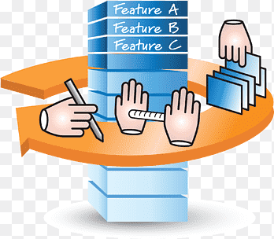
How to Write an Epic
As a product manager/owner while creating an epic include the following four things as the very basic structure.
Introduction
Product requirement
Engineering requirement
Design requirement
https://productcoalition.com/how-to-write-epics-and-user-stories-best-practice-1de5b983900

Slide 38
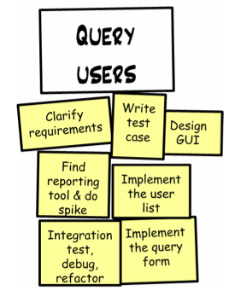
Breaking Stories into Tasks

Slide 39
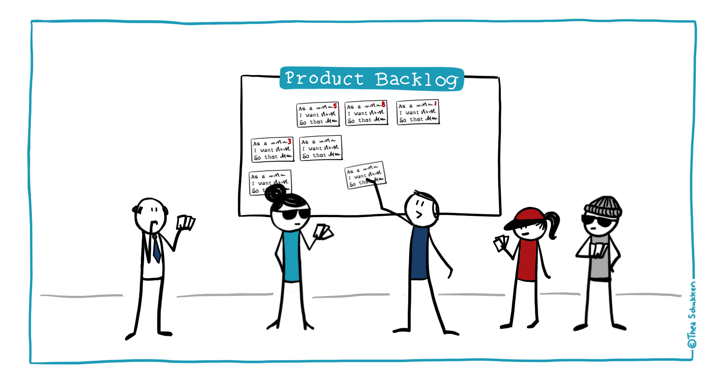
Story Points
Its purpose is to measure the effort needed to implement a user story.

Slide 40
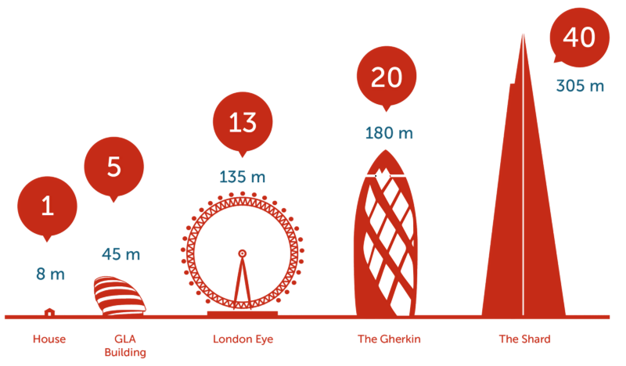
Story Points
You can use any measure to give story points (It’s flexible according to the team’s comfort level as Agile is based on flexibility and adaptability).
You can use numbers ranging from 1 to 10; numbers in powers of 2 (1, 2, 4, 8, 16, etc.); Fibonacci series, etc.

Slide 41
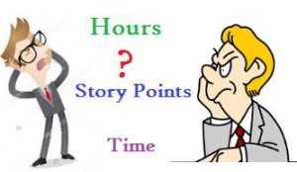
Story Points
A story point corresponds approximately to 1 ideal man/day (8h work).

Slide 42
Unit 6.2 – Software Engineering Review

